Slide 1
Movie Director as a Leader
Made by: Arseniy Zaitsev

Slide 2
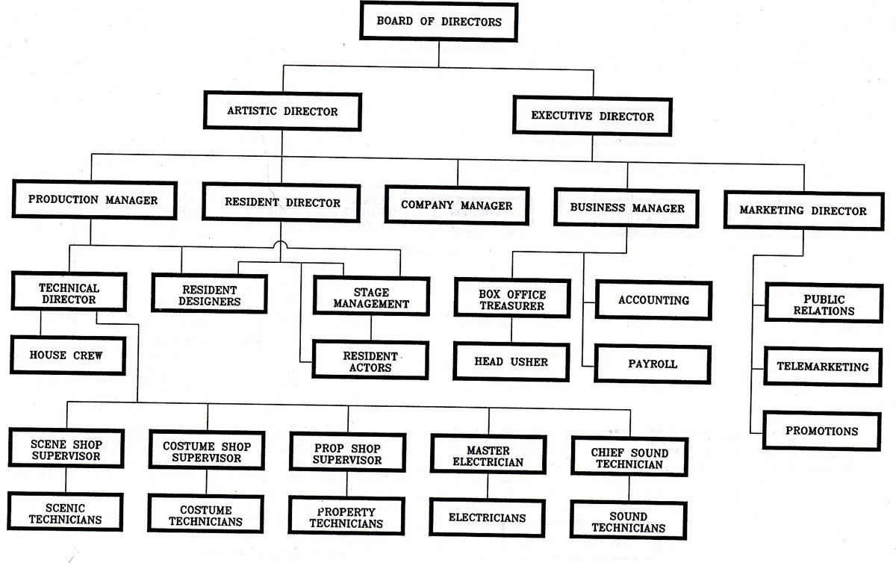
Hierarchy of film making

Slide 3
What leader traits a film director must have?

Slide 4
Responsible

Slide 5
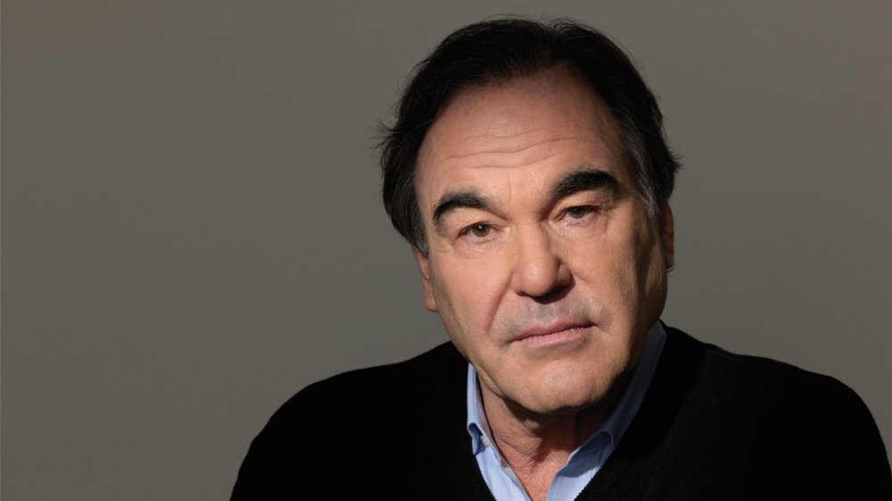
Oliver Stone, film director

Slide 6
Traits:
Prepared
Consistent
Focused

Slide 7
Balanced

Slide 8
Traits:
Stress-resistant
Full of vital energy
Confident
Brave

Slide 9
Desicive

Slide 10
Traits:
“Reshala”
Brave
Responsible

Slide 11
Intelligent

Slide 12
Traits:
Feeling
Manipulative
Charismatic

Slide 13
Humane

Slide 14
Traits:
Inspiring
Encouraging
Thankful
Empathic

Slide 15
A movie director is:
Responsible
Balanced
Desicive
Intelligent
Humane

Slide 16
Thank you!

